Slide 1

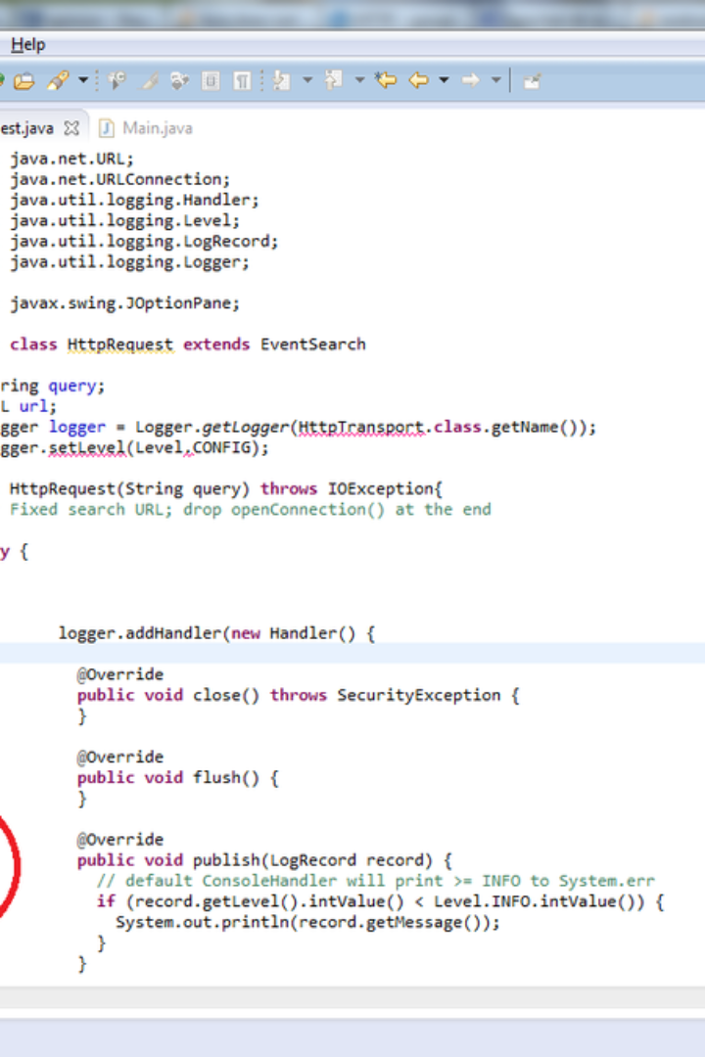
Introduction to JAR files
JAR (Java Archive) files are a way to bundle multiple files into a single archive. They are used to distribute a set of Java classes, associated metadata, and resources to create a single file.
Na
by MhdSalahu

Slide 2

What is a JAR file?
1
Compact Packaging
2
Platform Independence
3
Archiving Resources
JAR files compress all the files within them, making it easier to distribute and manage.
JAR files are platform-independent, allowing them to run on any system with Java support.
They store metadata, resources, and class files in a single unit to simplify deployment.

Slide 3
Benefits of using JAR files
Efficient Deployment
Library Management
JAR files streamline the process of deploying and distributing Java applications.
They serve as a container for libraries, facilitating version management and reuse.

Slide 4
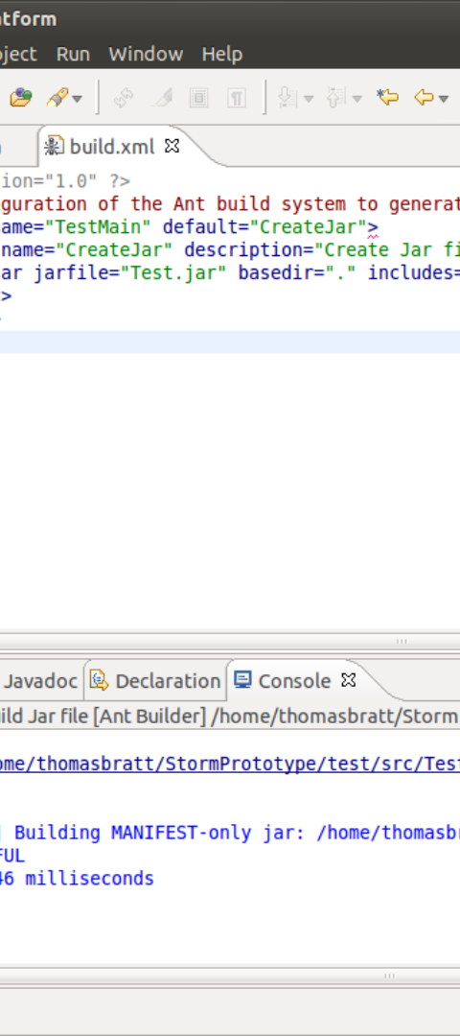
Creating a JAR file
1
Compilation
Compile all the necessary Java source files to generate the .class files.
2
Structure Definition
Create a manifest file to define the structure of the JAR file.
3
Archival
Use the jar command to create the JAR file by archiving the compiled files and manifest.

Slide 5
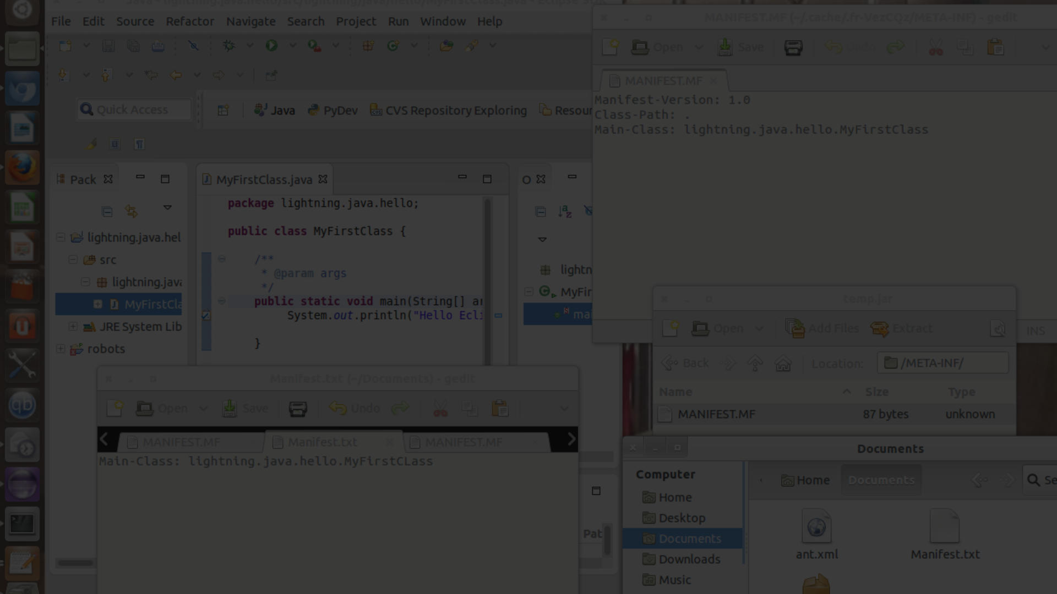



Steps to create a JAR file
Compile
Create Manifest
Archive
Compile source files
Define the main class and any dependencies in the manifest file.
Archive compiled files and manifest using the jar command.

Slide 6
Create a JAR file
jar cf jarfilename inputfiles
Here, cf represents to create the file. For example , assuming our package pack is available in C:\directory , to convert it into a jar file into the pack.jar , we can give the command as:
C:\> jar cf pack.jar pack
View a JAR file
jar tf jarfilename
Here, tf represents the table view of file contents. For example, to view the contents of our pack.jar file, we can give the command:
C:/> jar tf pack.jar

Slide 7
Extracting JAR File
jar xf jarfilename
Here, xf represents extract files from the jar files.
Updating a JAR file
jar uf jar-file input-file(s)
Here ‘uf’ represents the updated jar file.
Running a JAR File
In order to run an application packaged as a JAR file (requires the Main-class manifest header), the following command can be used as listed:
C:\>java -jar pack.jar

Slide 8
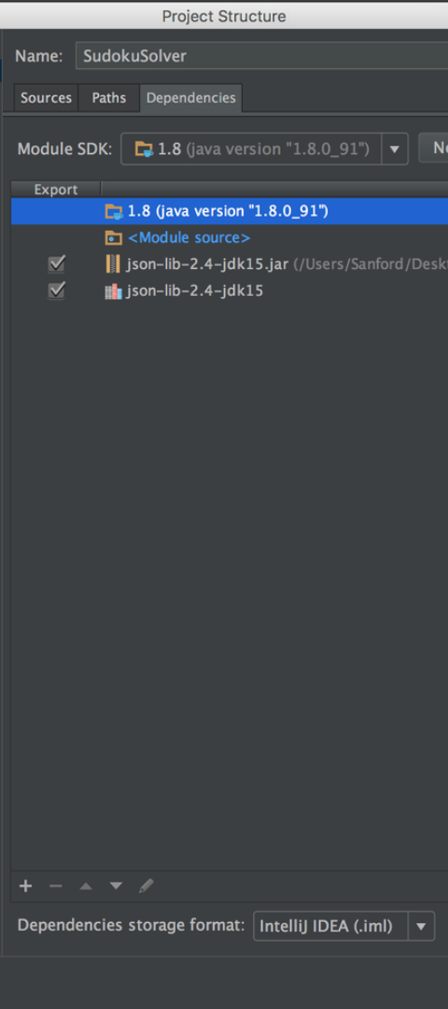
Including dependencies in a JAR file
Considerations
Manifest Configuration
Ensure all required libraries and resources are included for seamless functionality.
Update the manifest file to specify external dependencies, specifying the classpath.

Slide 9
Executing a JAR file
1
2
Command Line
Executable JARs
Run the JAR file using the Java command with the -jar option.
Create executable JAR files by specifying the main class in the manifest file.

Slide 10
Best practices for JAR file creation
1.
Use clear and descriptive names for classes and resources.
2.
Include documentation and version information in the JAR file manifest.
3.
Organize packages and files logically to enhance readability and maintenance.

